Slide 1
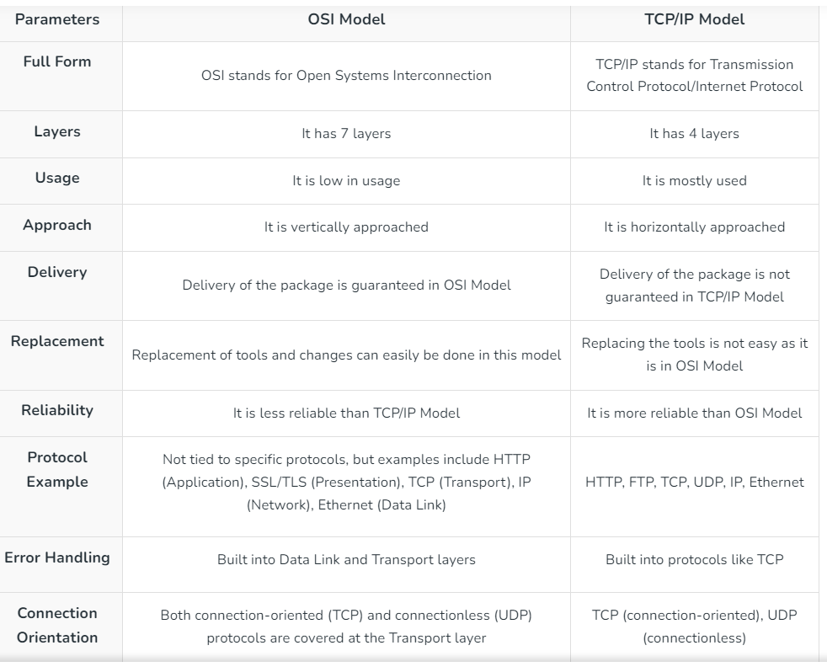
The TCP/IP model was developed prior
To the OSI model. So, TCP/IP is the actual implemented model & OSI is just a guideline.

Slide 3
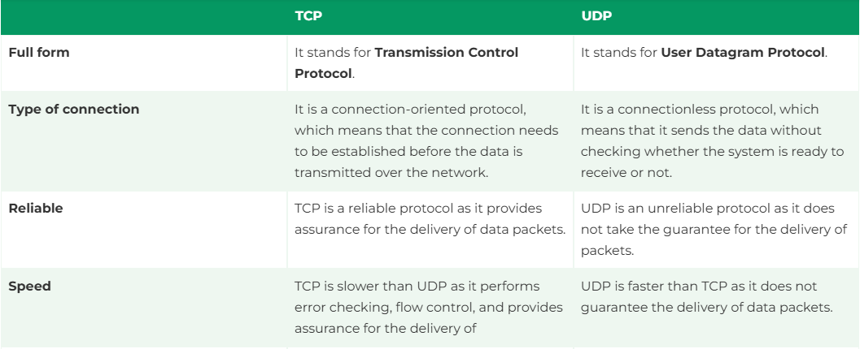
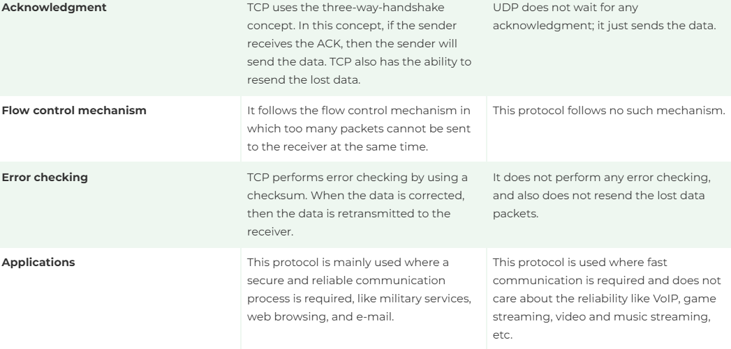

Slide 4
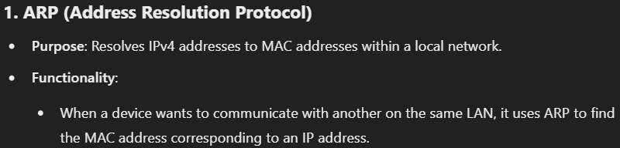
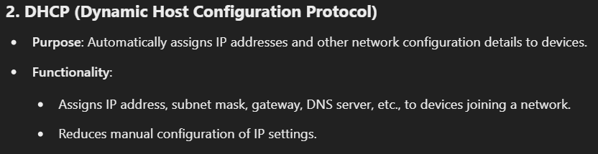
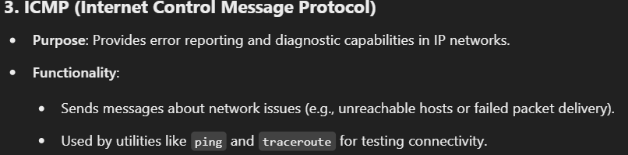
IP support protocols (ARP, DHCP, ICMP)

Slide 5
Network Address Translation (NAT)
Does the conversion of private ip address to public ip address in
During receiving acknowledgement converts public ip address top private ip address
After Ipv6 there is no need of nat because it has 2^128 address space

Slide 6
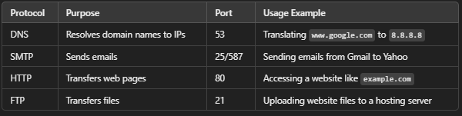
Application layer protocols: DNS, SMTP, HTTP, FTP, etc

Slide 7
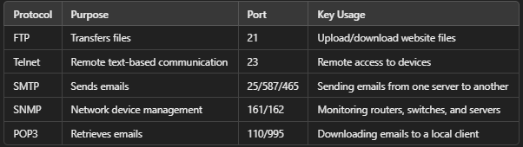
Internet Application Protocols
(FTP, Telnet, SMTP, SNMP, POP3)
Extra:- https://www.geeksforgeeks.org/types-of-internet-protocols/

